Slide 1

RL project flappy bird based on
Q-learning and NEAT
PRESENTATION
Group 2

Slide 2
CATALOG
01
RL Elements and Policy
02
Q-learning Project
Fundamental features about the game
Code and analysis based on q-learning
03
NEAT Project
04
Result Analysis
Neuro-evolution of Augmenting Topologies
A better way to train the agent?

Slide 3
01
RL elements and policy
Fundamental features about the game

Slide 4
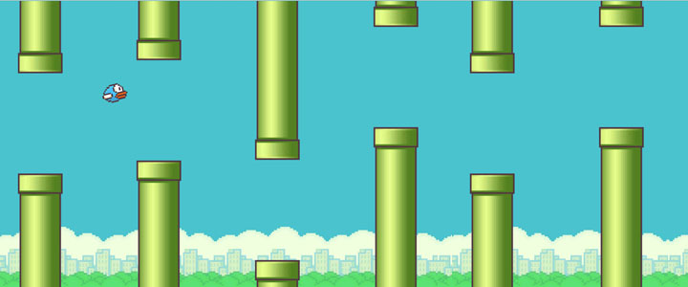
About the game:
There is a flying bird in the game. It will encounter obstacles in the pipeline during the flight. Players need to control the bird to fly upwards. During the flight, they cannot fall to the ground or touch the obstacles. If they continue to perform actions, they will fly higher and higher; if not, it will descend quickly.

Slide 5
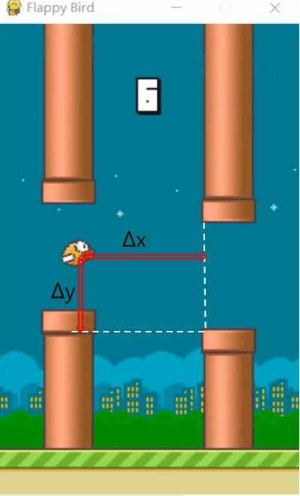
STATE
State space
Specific implementation method
Each horizontal distance and vertical distance form a two-tuple, which can show the state of the agent
Dead
Or
Alive?
How many states?
Based on the game mechanics, the coordinate will change 4 units in every frame.
(max(Δx)-min(Δx))*(max(Δy)-min(Δy))/16

Slide 6
Action and Reward
Jump or not jump
Reward
If in a certain state, the agent chooses to jump and give the bird an upward speed.
Without jumping, the bird will fall at a constant acceleration with gravity.
Our idea is to add 1 point to the score of the bird if the bird does not die after each status update, and deduct many points if the bird dies.

Slide 7
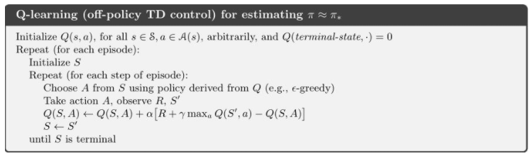
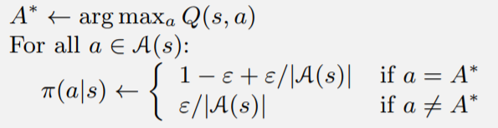
How to find the optimal policy

Slide 8
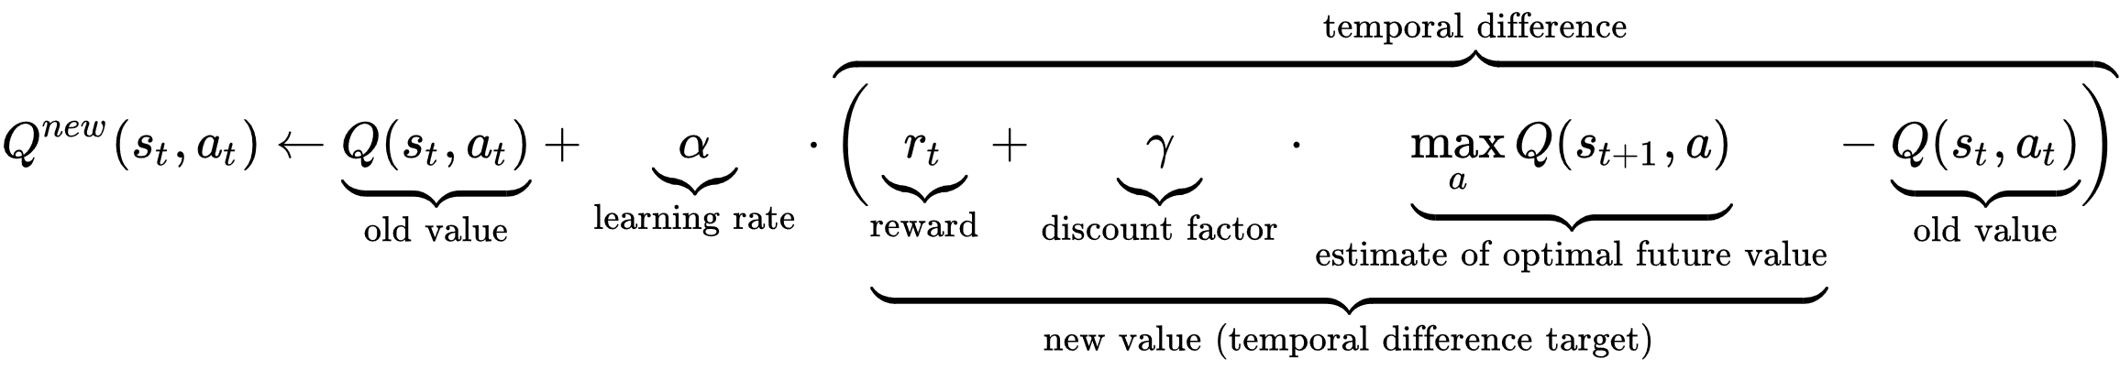
Some explanations about the parameters:
The learning rate (0~1) or step size determines to what extent newly acquired information overrides old information.
The discount factor (0~1) determines the importance of future rewards.

Slide 9
02
Q-learning Project
Flappy Bird Based On Q-learning

Slide 10
Project modules
01
flappy.py
02
algorithms.py
its role is to design an environment that the agent interacting with.
its role is to update each value of the Q-table until it reaches the convergence state.
03
evaluate_bird.py
04
test.py
it's a training process,circulating thousands of episodes to get the final Q-table.Besides,it needs to record the score of each episodes and count the average score in every series to show the training result in form of a line chart.
it's finally pickaged game,
which uses the final Q-table as agent's policy.

Slide 11
Module:flappy.py
class: FlappyBird
FPS
_LIST
score
deltax/delty
playerx/playery
num_states
num_actions
lowerPipes
crashTest
SCREENWIDTH/
SCREENHIGHT
pipeVelX
playerVelY
lookup()
reset()
next()
init()
is_terminal()
main()

Slide 12
Module: Algorithms.py
Func:q-learning()
flappy.py
initialize
state0
evn.reset()
policy
ε-greedy()
loop
evn.is_terminal()
s',r=evn.next()
NO
a=choose_from_policy()

Slide 13
Module: evaluate_bird.py
algorithms.py
result.png
Func:evaluate_learning()
final Q-table
initialize
series_size
num_series
gamma
YES
loop
Func:q_learning()
alpha
episode<series_size*num_series
Q-table
epsilon
save.npy

Slide 14
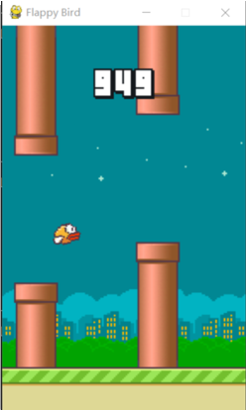
Result analysis
test.py: use the trained Q-table to play the game in an episode, the result is
as following figure shown:
所有省份可任意编辑
您的内容打在这里，或者通过复制您的文本后，在此框中选择粘贴，并选择只保留文字。您的内容打在这里，或者通过复制您的文本后，在此框中选择粘贴，并选择只保留文字。
您的内容打在这里，或者通过复制您的文本后，在此框中选择粘贴，并选择只保留文字。
After 5000 times training the brid can already get very high score and it can survive to the ·end of the game interface width.

Slide 15
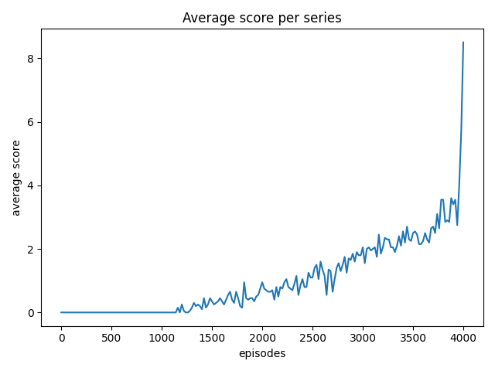
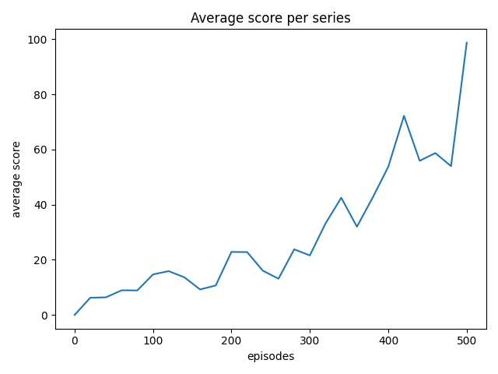
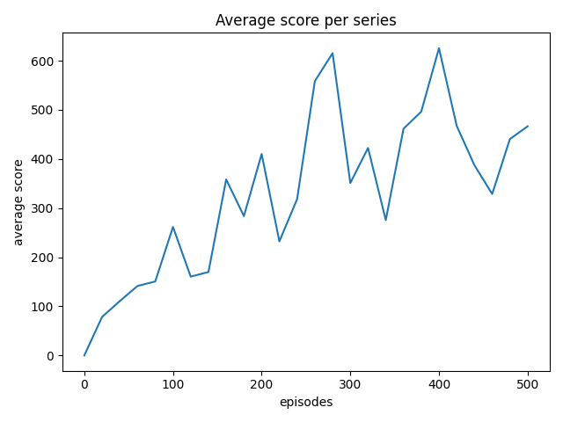
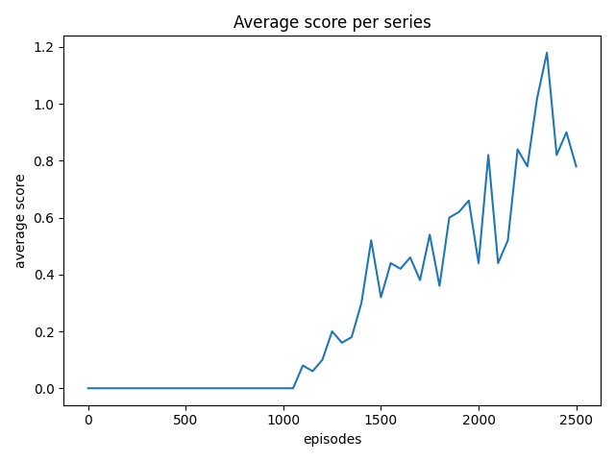
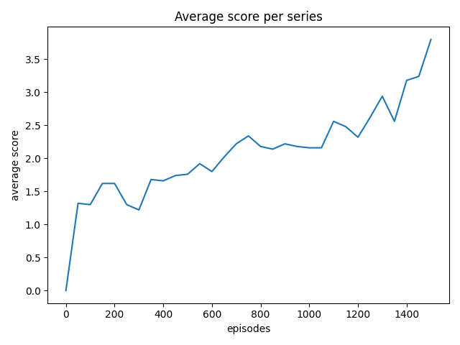
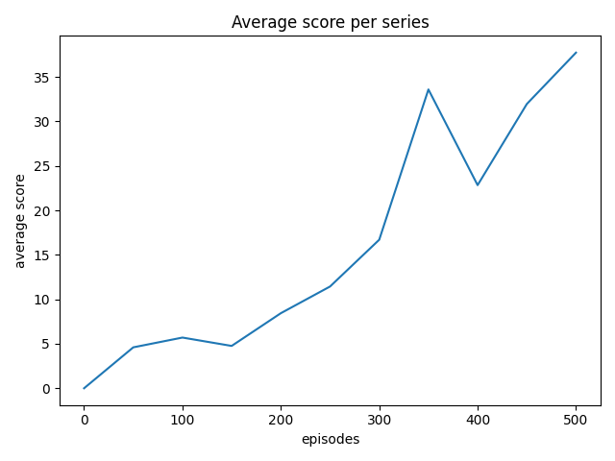
Result analysis
GAPSIZE=150 PIPEVELX=-4
GAPSIZE=100 PIPEVELX=-4

Slide 16
Result analysis
Compared with playing games manually, the scores of people playing games show randomness,and people have advantage in the beginning, but AI can get higher score by training constantly.

Slide 17
03
NEAT project
Neuro-evolution of Augmenting Topologies

Slide 18
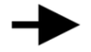
NEAT
NeuroEvolution of Augmenting Topologies (NEAT) :
A genetic algorithm for the generation of evolving artificial neural networks.
Many individuals.
Compete, eliminate, reproduce ,mutate.
(selection) (crossover) (mutation).
generation i
generation i+1

Slide 19

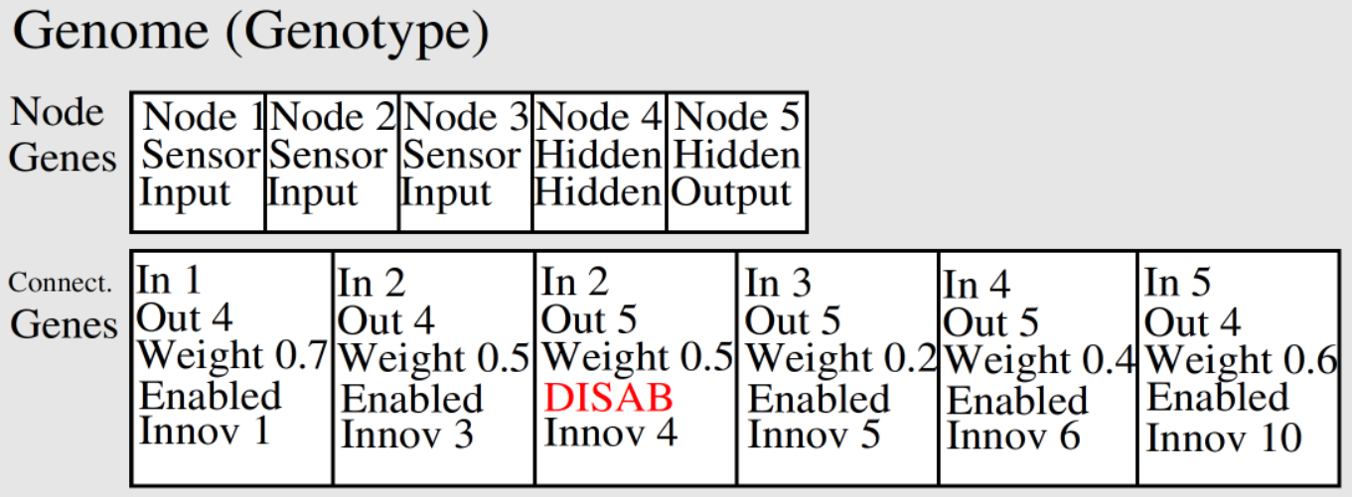
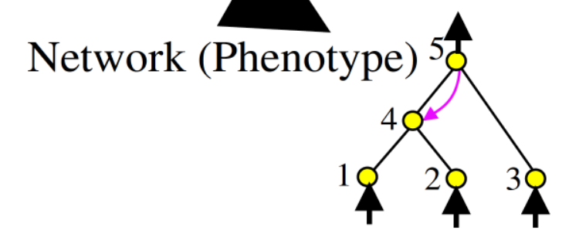
NEAT
Combining genetic algorithm with neural network.
Neural network
Genome

Slide 20
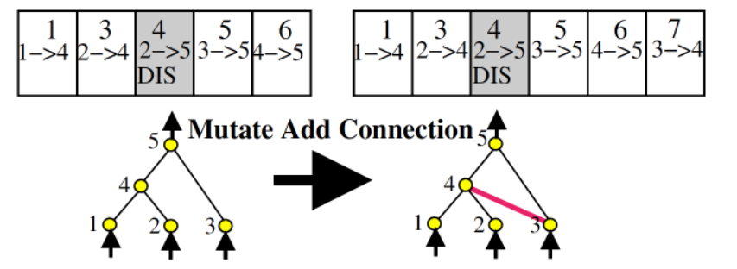
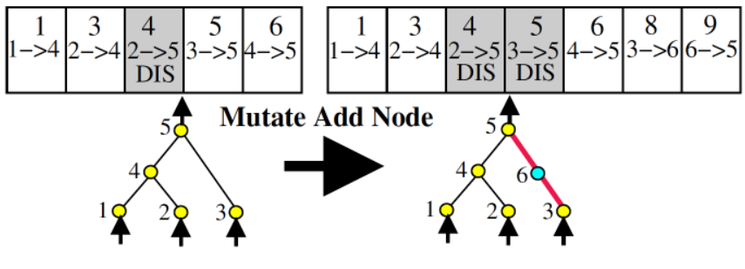
Mutation
There are 3 ways for mutation.
adding or deleting a node.
adding or deleting a connection.
changing weight within a certain range.
One more disabled record.

Slide 21
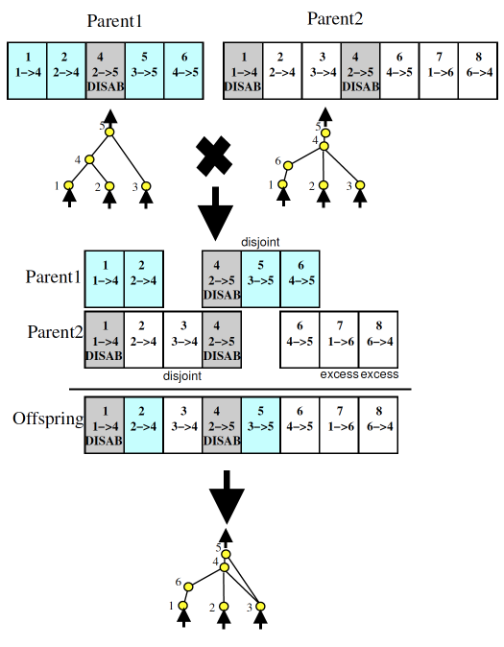

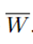
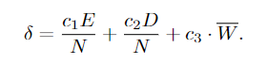
Crossover
Reproduction----crossover
Aligned by innovation ID.
Randomly selected at the same location.
Disjoint genes: (whose number is D )
The other parent has the node but not the connection.
Excess genes: (whose number is E )
The other parent does not have the node.
compatibility distance δ
is the average weight differences of matching genes.

Slide 22
Protecting Innovation with Speciation
（potential ↑ fitness ↓)
Problem:
new
δ :
Compete within species:

Slide 23
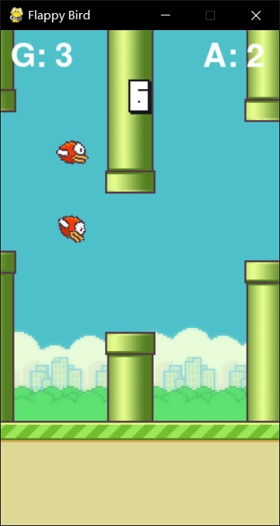
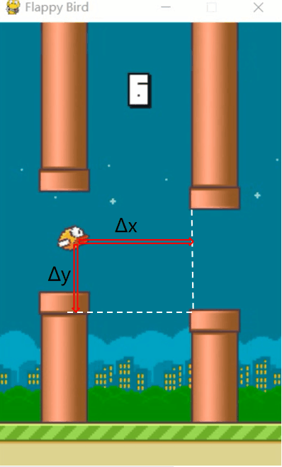
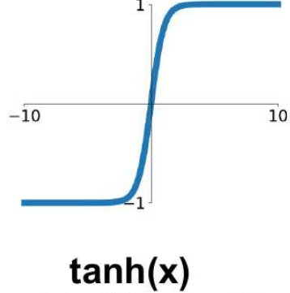
How do I apply the NEAT
>0.5: jump
x
T
A
L
b
bias
<0.5: not jump

Slide 24
How do I apply the NEAT
may change
Best

Slide 25
System
Visualization module
NEAT module
Class: Bird
Class: Pipe
Class: Base
Func: …
Configuration.txt
Func: evaluate_genomes
Func: run

Slide 26
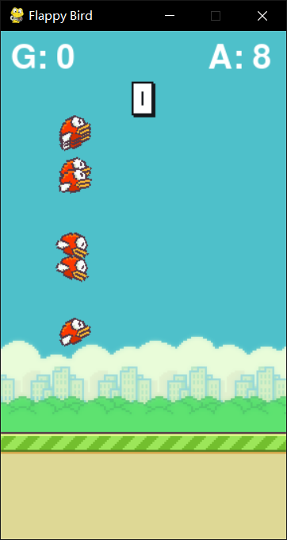
Func: evaluate_genomes
input
Mian of game
convert
Genome list
net list
decide
Bird list
Pipe list
Base
Reward = fitness of genome ：about score
output
Genome.fitness

Slide 27
Func: run
Configuration.txt
initialize
Genome list
NEAT
loop
selection
crossover
Func: evaluate_genomes
mutation
Visualization

Slide 28
04
Result Analysis
A better way to train the agent?

Slide 29
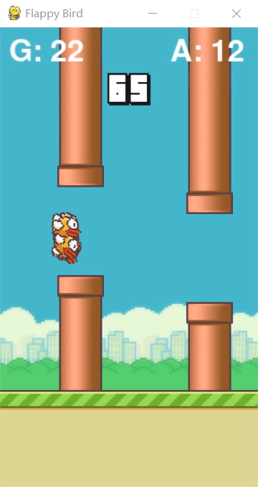
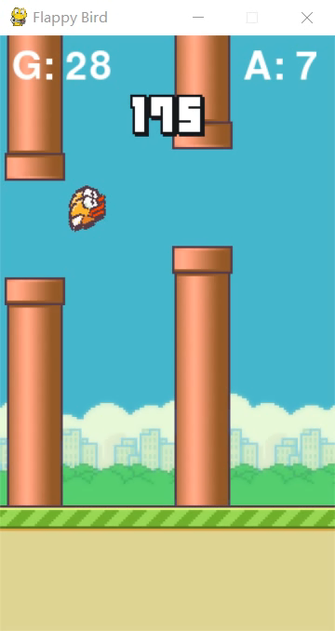
Training
more difficult game
With the help of my teammate Qin, we improved the difficulty of the game. For example, we increase the randomness of the gap position between the upper and lower pipes and appropriately reduce gap size.
This is the process of training.

Slide 30
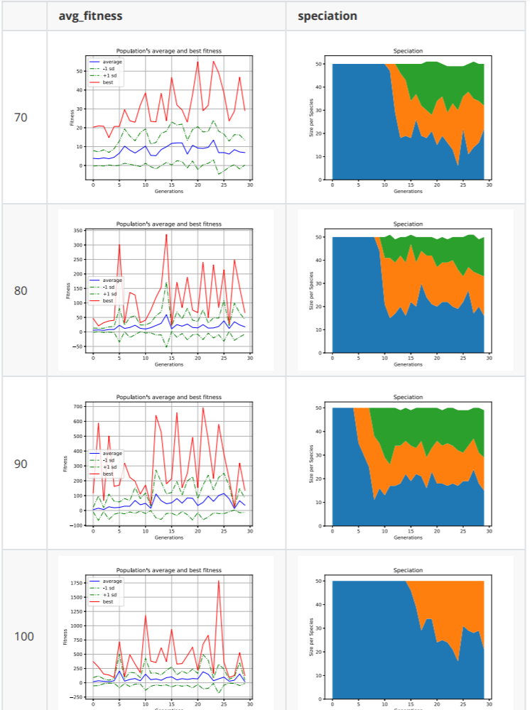
Result 1
Description:
The following content shows the performance of Flappy Bird based on NEAT algorithm at different latitudes.
Here we control for the same other variables, looking at the performance of the obstacle gap for the bird over the obstacle

Slide 31
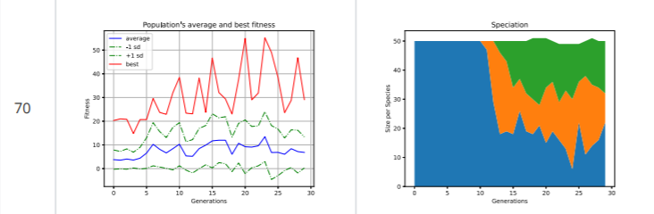
Result 1
Two ways：Mutation adds node or connection.
If a mutation node is added to the original connection, the original connection will be disabled.

Slide 32
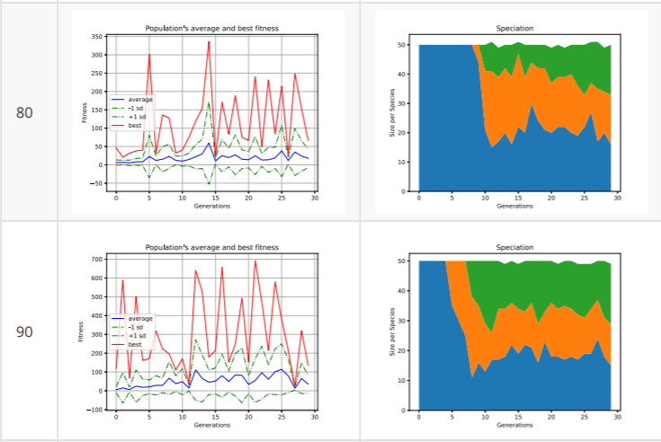
Result 1
Two ways：Mutation adds node or connection.
If a mutation node is added to the original connection, the original connection will be disabled.

Slide 33
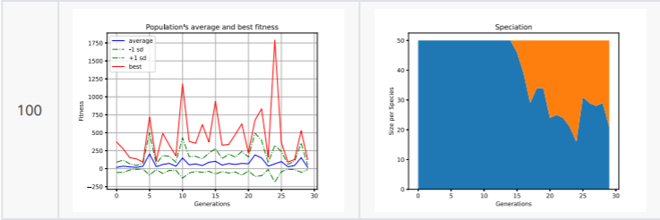
Result 1
Two ways：Mutation adds node or connection.
If a mutation node is added to the original connection, the original connection will be disabled.
Vertical comparison shows that the strategy of simply increasing the gap value reduces the difficulty of implementation, which can make neat_Flappy_bird's performance get better and better, and its fitness degree is also greatly improved

Slide 34
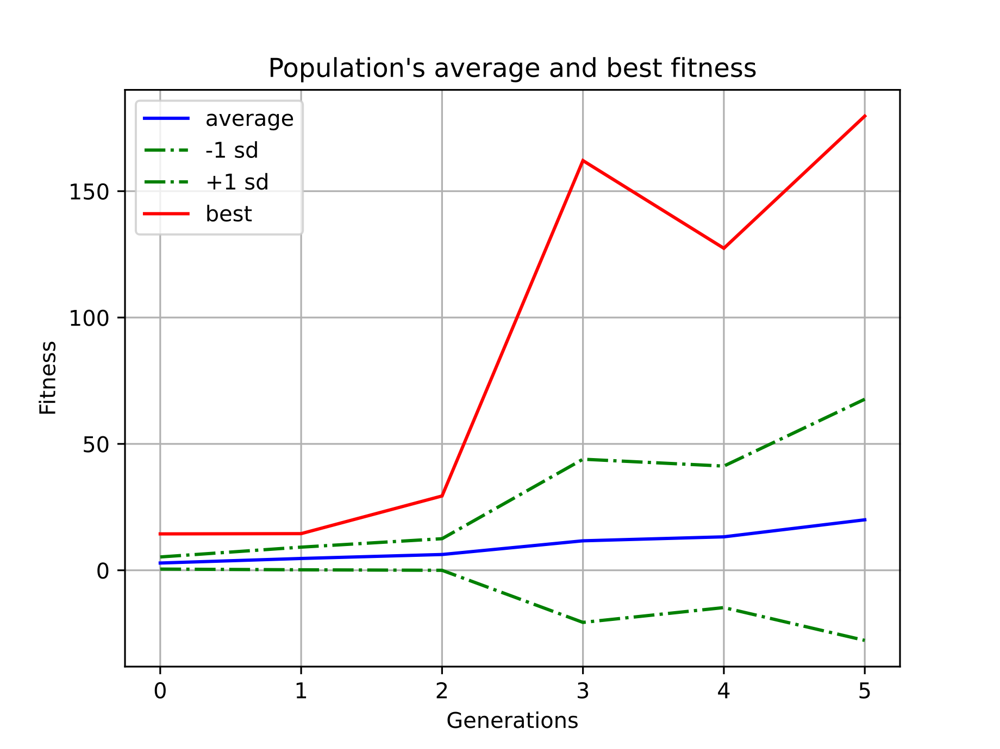
Result 1

Slide 35
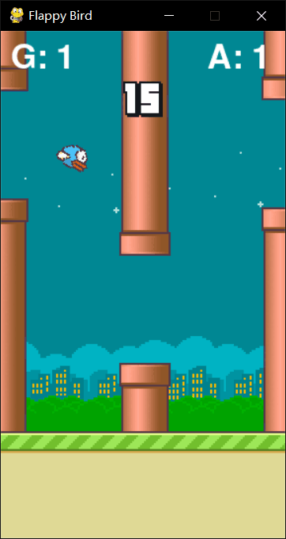
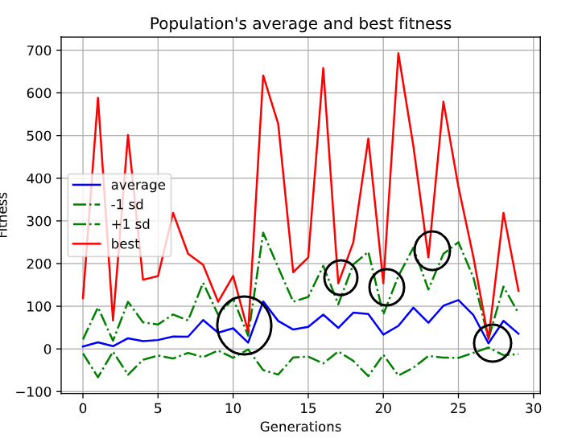
Result 1

Slide 36
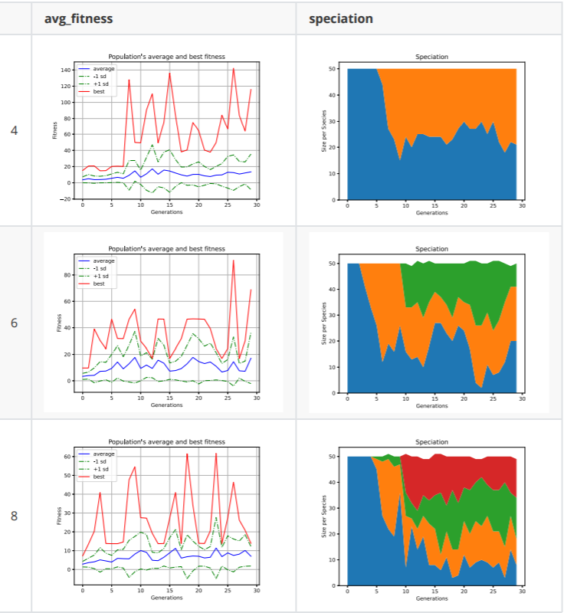
Result 2
So we studied the bird representation based on the relative speed of the bird and the obstacle, to explore at what speed the bird can learn to avoid the obstacle as intelligently as possible.

Slide 37
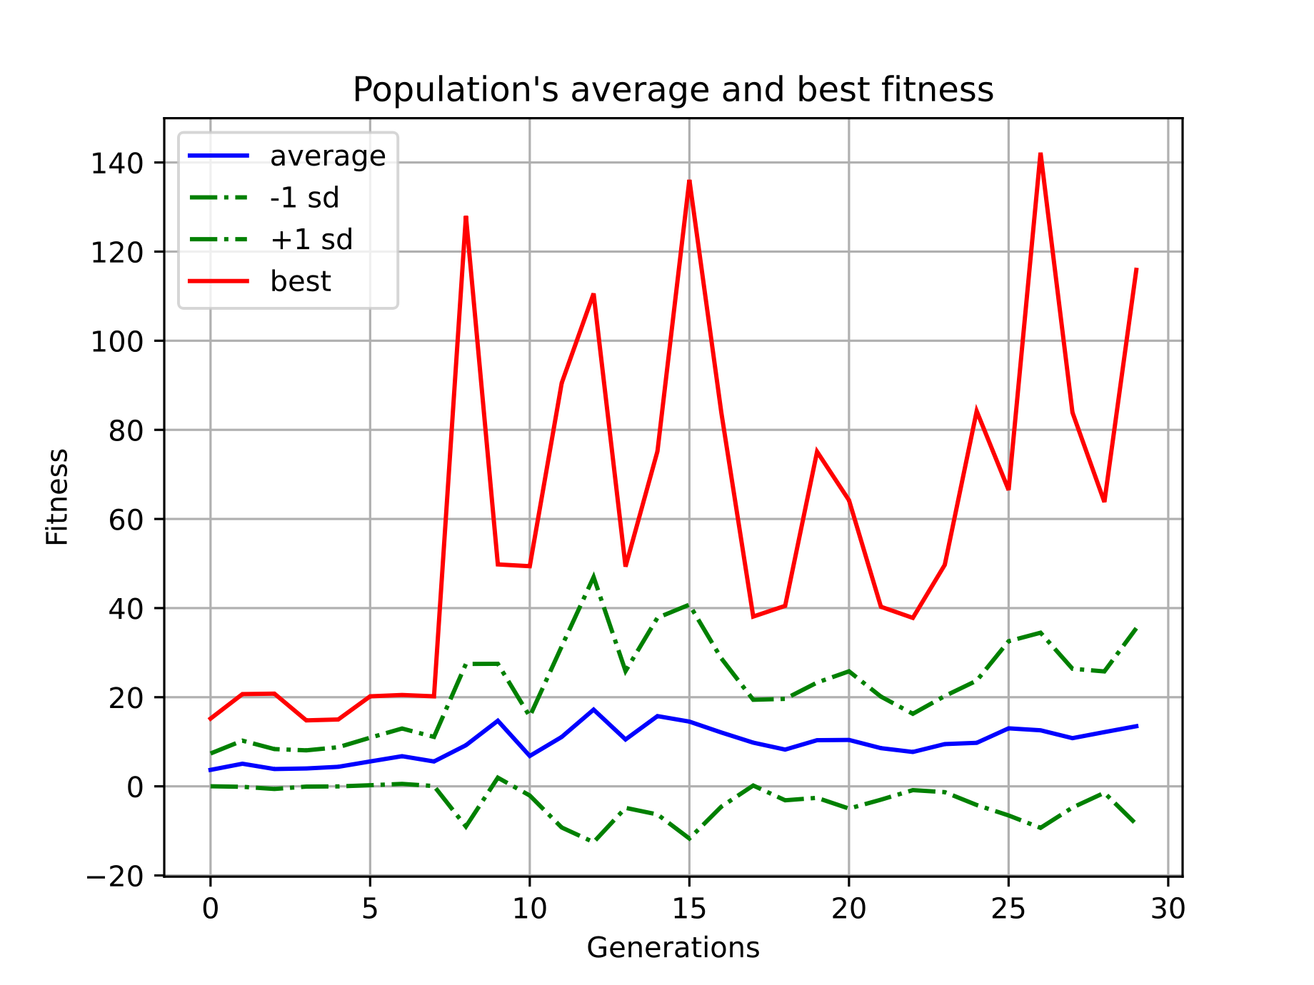
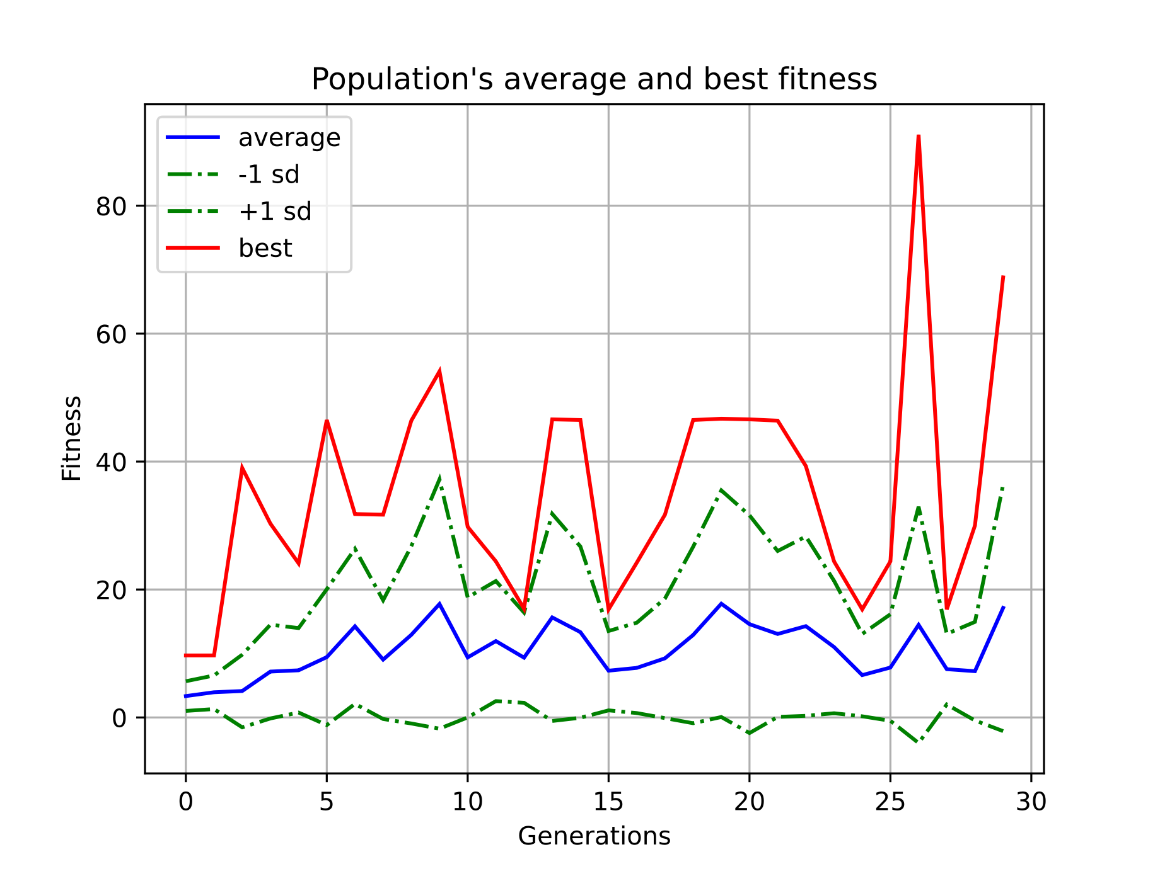
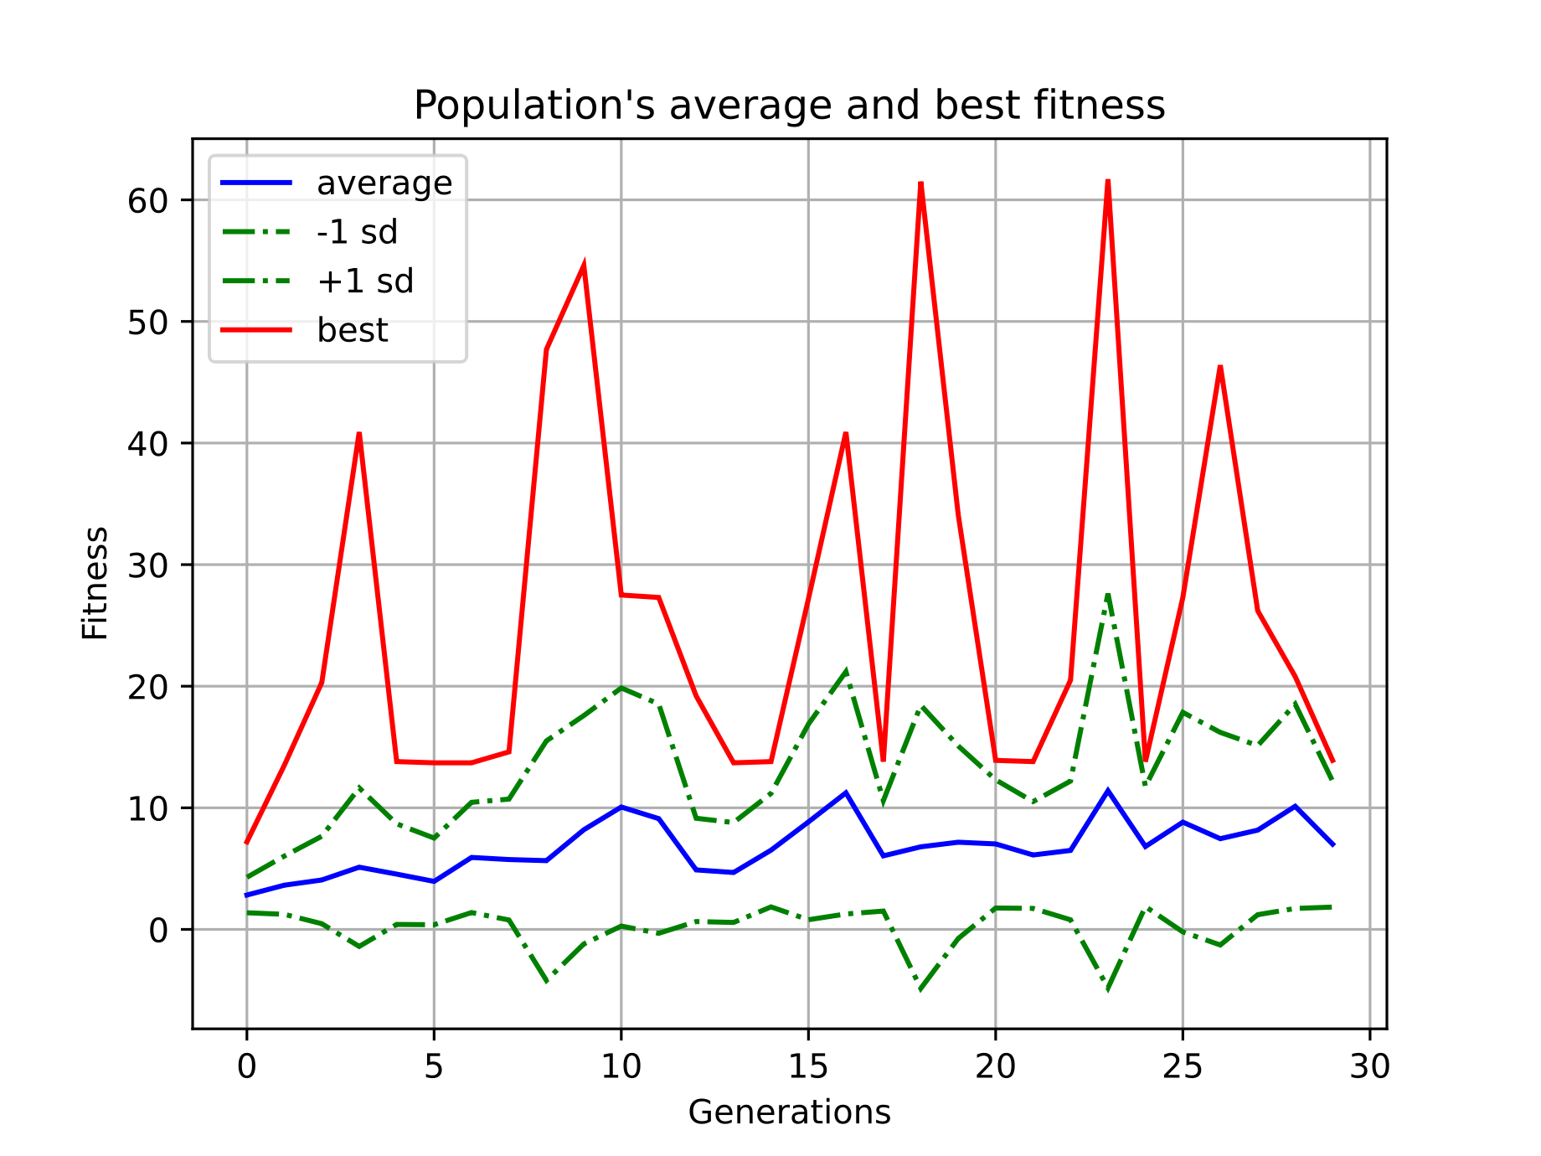
Result 2
Two ways：Mutation adds node or connection.
If a mutation node is added to the original connection, the original connection will be disabled.

Slide 38
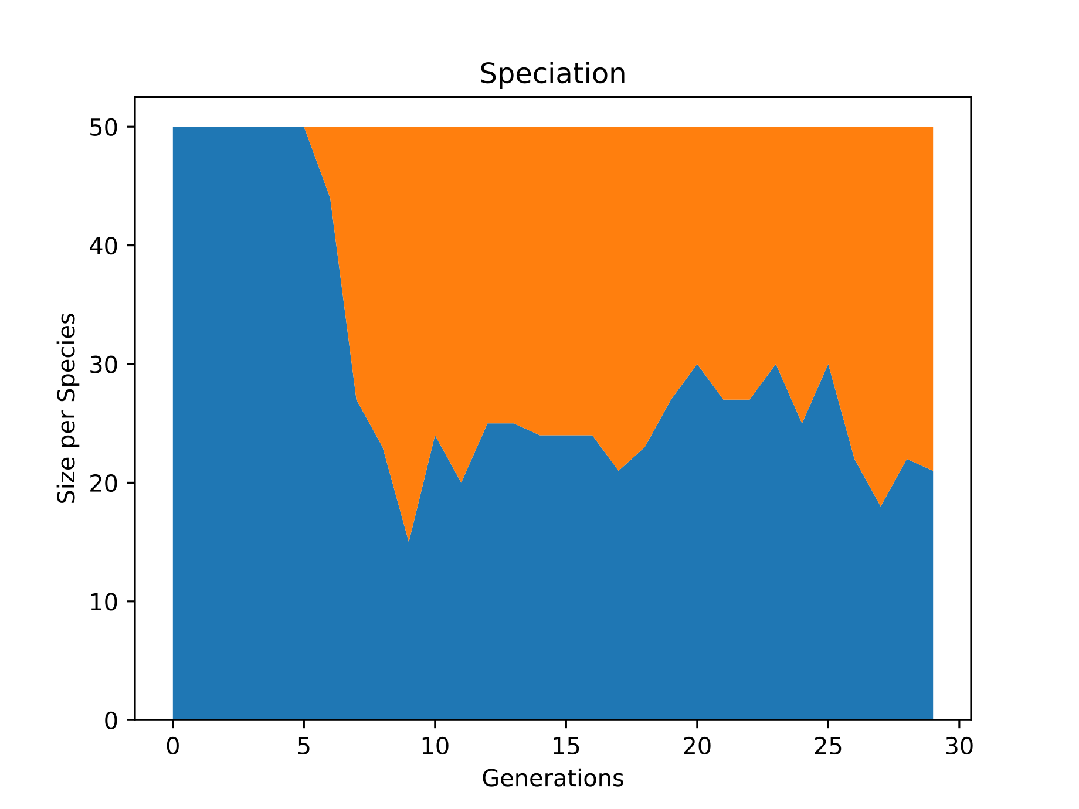
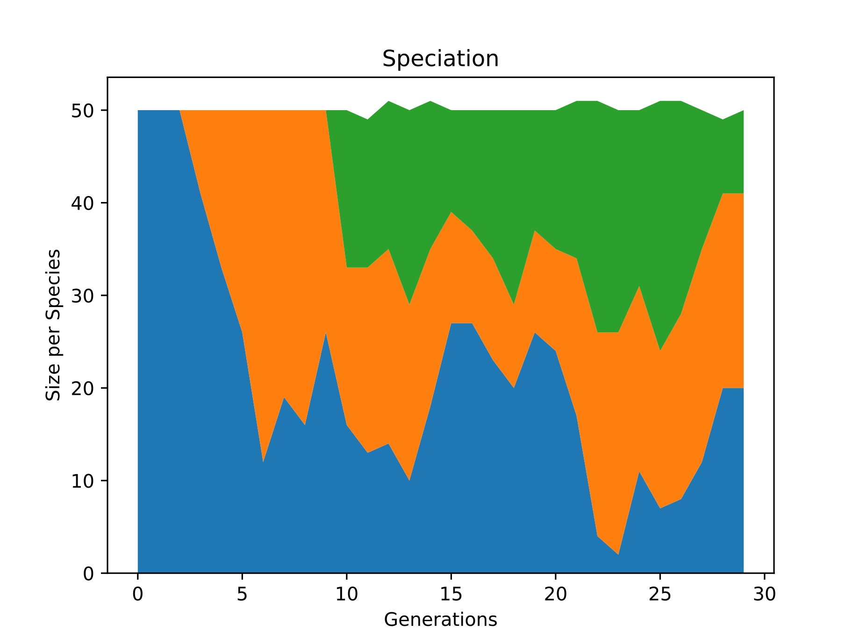
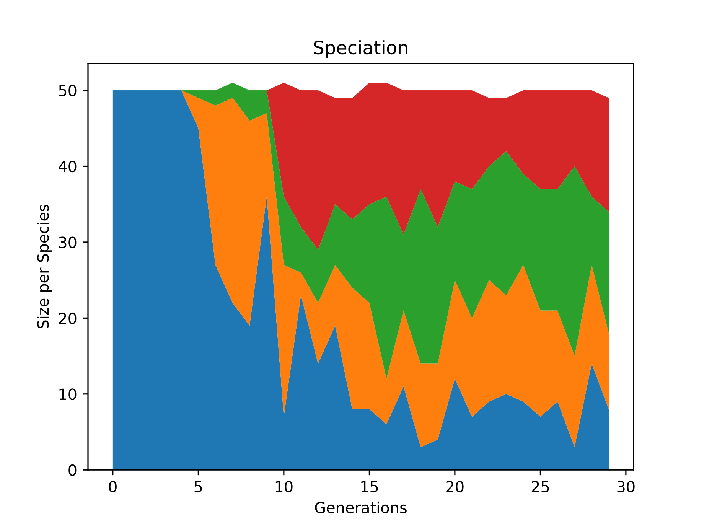
Result 2 -- SPEED
6
4
We found that as the difficulty increased, more species appeared, and more patches of color appeared on the diagram. That is to say, the increase of difficulty promotes the occurrence of mutation, and the proportion of species obtained by new mutation also increases.

Slide 39
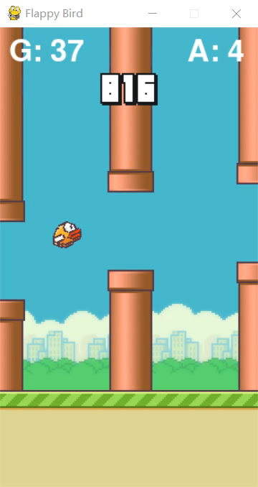
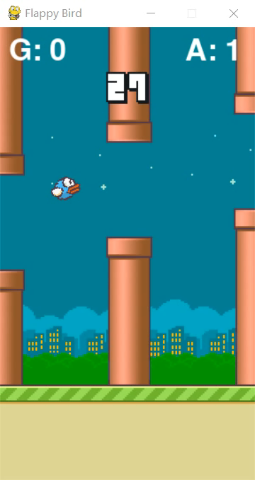
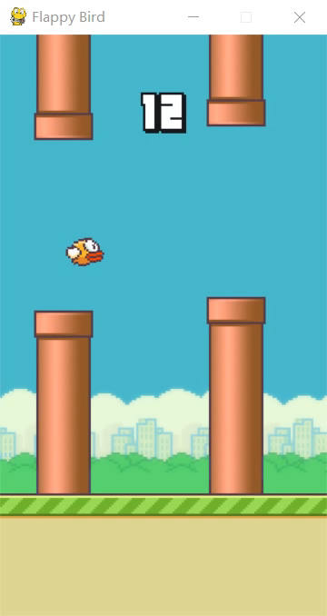
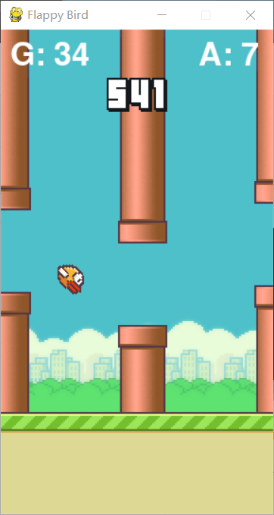
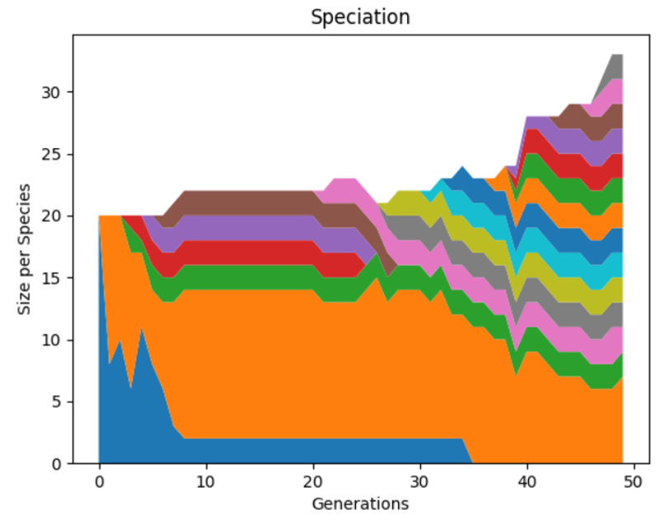
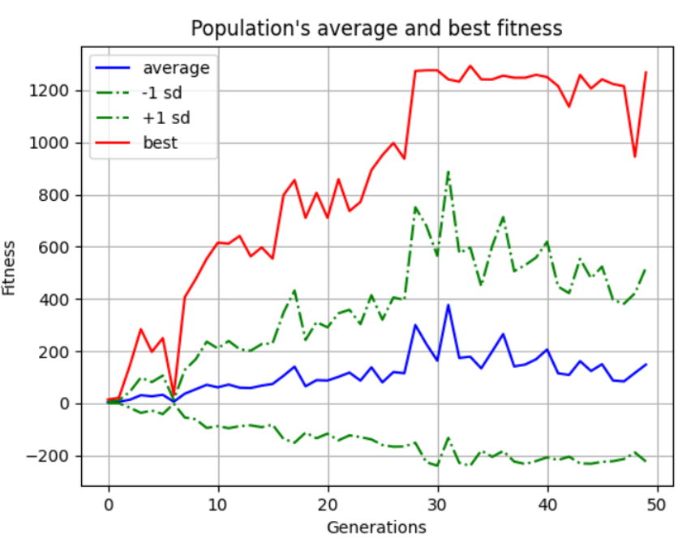
Final result

Slide 40
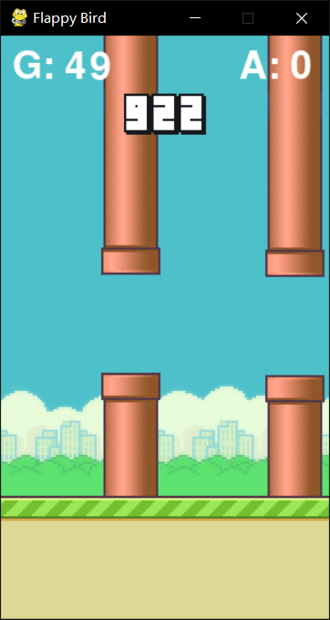
Thank you
Presentation by Group 2
Flappy bird

Slide 41
Thank you
Presentation by Group 2
Flappy bird

Slide 42
Thank you
Presentation by Group 2
Flappy bird

Slide 47

可以在下列情况使用
个人学习、研究。
拷贝模板中的内容用于其它幻灯片母版中使用。
不可以在以下情况使用
任何形式的在线付费下载。
网络转载、线上线下传播。
PPT模板： www.1ppt.com/moban/ 行业PPT模板：www.1ppt.com/hangye/
节日PPT模板：www.1ppt.com/jieri/ PPT素材： www.1ppt.com/sucai/
PPT背景图片：www.1ppt.com/beijing/ PPT图表： www.1ppt.com/tubiao/
优秀PPT下载：www.1ppt.com/xiazai/ PPT教程： www.1ppt.com/powerpoint/
Word模板： www.1ppt.com/word/ Excel模板： www.1ppt.com/excel/
个人简历： www.1ppt.com/jianli/ PPT课件： www.1ppt.com/kejian/
手抄报： www.1ppt.com/shouchaobao/ 试题下载： www.1ppt.com/shiti/
教案下载： www.1ppt.com/jiaoan/ 字体下载： www.1ppt.com/ziti/

